Slide 1

NEXT LEVEL
Gaming & Esports Arena
Website & mobile app design, wireframes and live demo
XHAW5112 · Task 3 · Group Presentation
Miehleketo Hlayiseko Magagula · Karabo Mashishi · Tshepang Masoka
Notes:
Introduce the group and the client: Next Level Gaming & Esports Arena in Sandton, Johannesburg.

Slide 2
What we'll cover
Each team member presents at least one topic
1
Website design, and why
Karabo Mashishi
2
The logo & colour palette
Miehleketo Magagula
3
Wireframes, and how they became the site
Miehleketo Magagula
4
Mobile app design & demo
Tshepang Masoka
5
Live website demo
Karabo & Miehleketo
Notes:
Presenters follow the Phase 2 task allocation (Karabo: website design, Tshepang: app design, Miehleketo: wireframes, palette and repo). Swap if your team agrees otherwise.

Slide 3
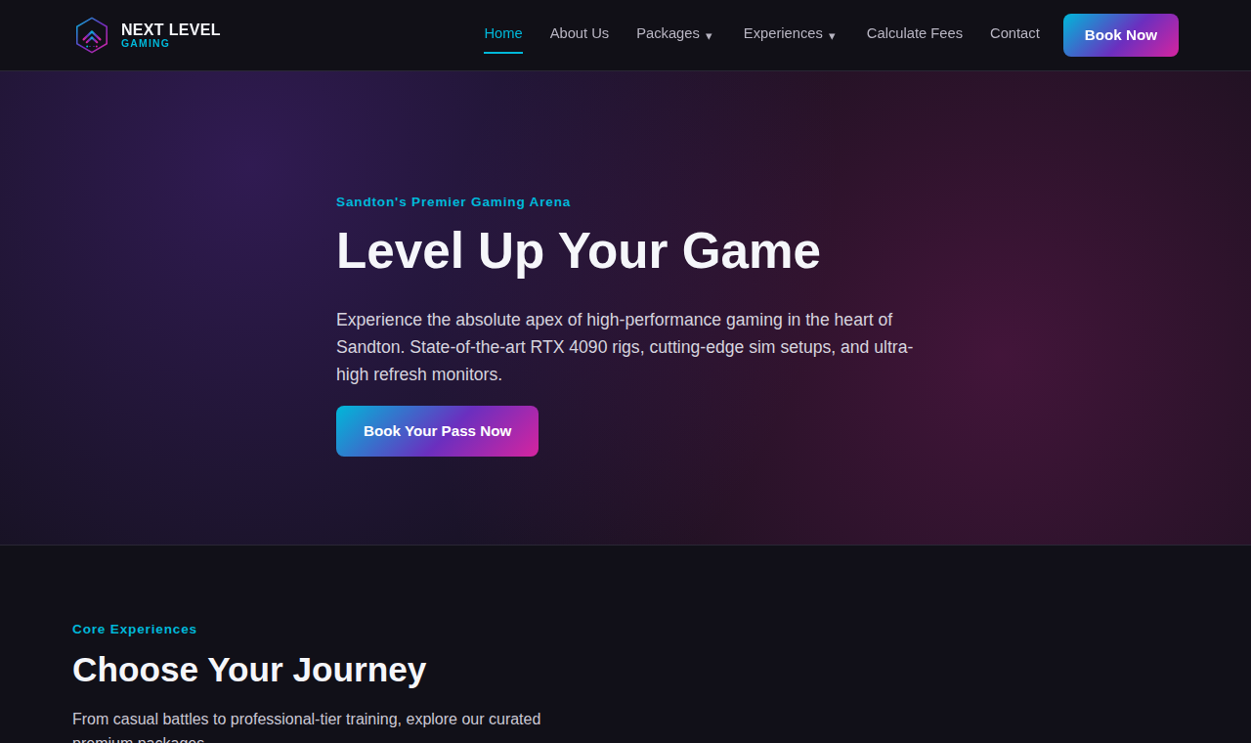
Website design & why
Built for gamers, usable by everyone
Dark theme with cyan, purple and magenta accents: the look of a gaming setup and easy on the eyes in a dim arena
Card layout: each package or experience is a scannable block with price and one clear action
Shared nav, footer and logo built once and reused, so every page stays consistent
Responsive: nav collapses to a menu on phones
Prices live in one data file, so no page can disagree with another
Presenter: Karabo Mashishi
Notes:
Explain WHY: audience is young gamers and corporate/party bookers in Sandton; the dark theme signals 'gaming', the cards make decisions quick.

Slide 4



Logo & colour palette
Three concepts compared; Miehleketo's hexagon badge was chosen
Matches the palette: the same cyan-purple-magenta gradient
Scales down to a 32px favicon / app icon
Hexagon = achievement badge; double chevron = 'level up'
Strongest written design rationale
Karabo
Tshepang
Chosen
Charcoal
#111018
Cyan
#00B8D9
Purple
#6B2FBF
Magenta
#D6249F
Off-white
#F5F6FA
Magenta is kept for calls-to-action like Book Now
Presenter: Miehleketo Magagula
Notes:
Reasons from the Phase 3 group submission, section 2.1. Karabo's hexagon NL monogram and Tshepang's controller+bolt were the other two concepts.

Slide 5
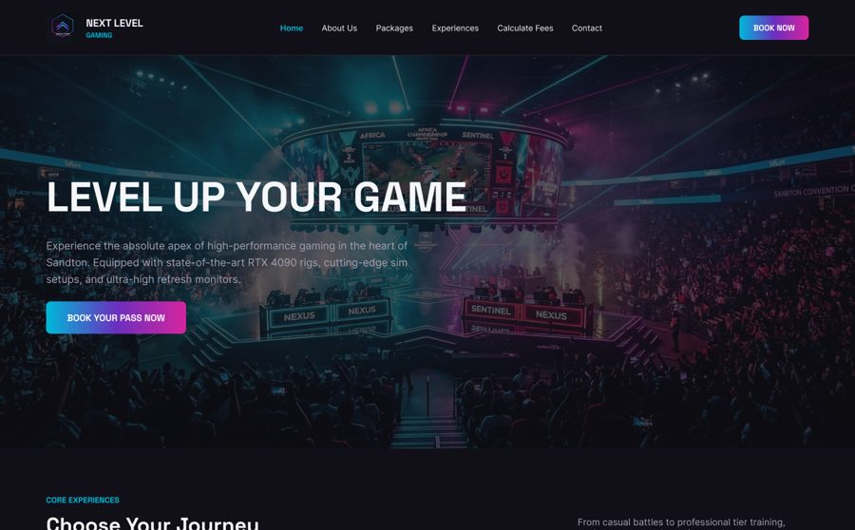
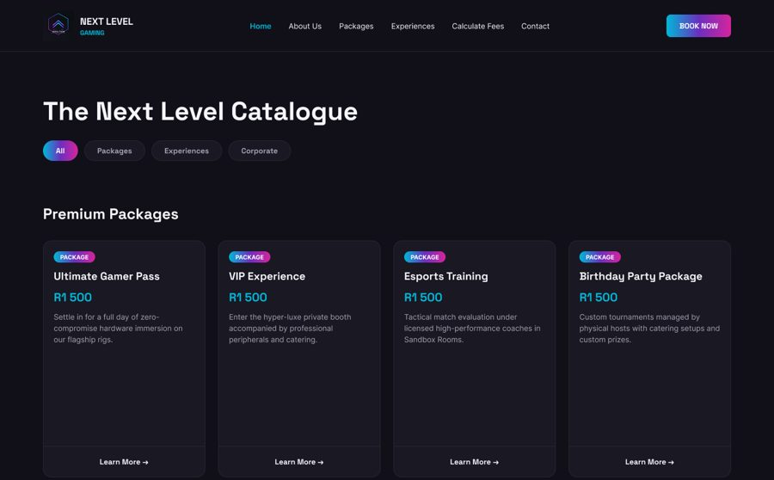
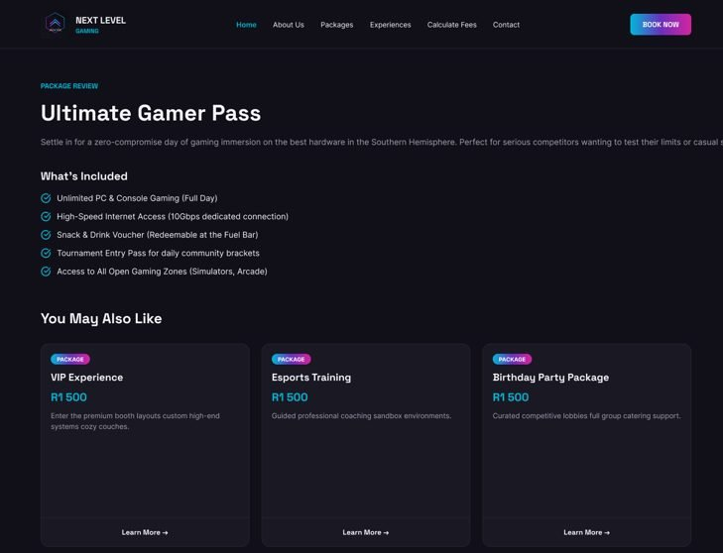
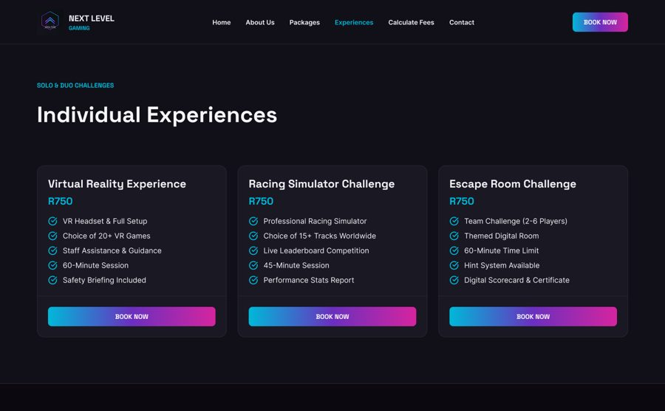
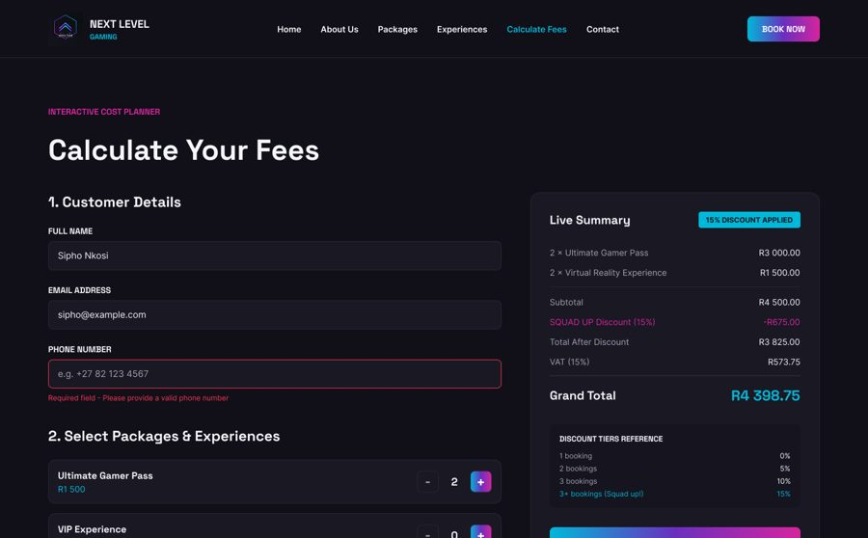
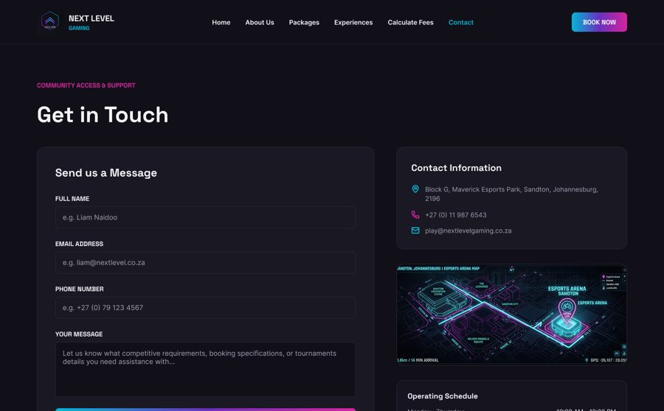
Website wireframes
12 Figma pages; key screens shown
Home
Overview
Individual package
Experiences
Calculate Fees
Contact Us
Also designed: About Us, 3 more package pages, Booking Summary, Confirmation
Presenter: Miehleketo Magagula
Notes:
The 12 website wireframes are in the group Figma file. Explain navigation flow and why each page exists.

Slide 6
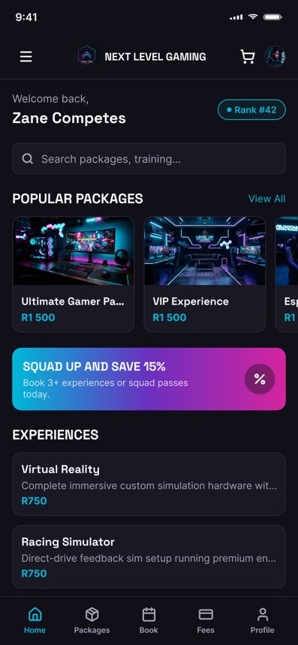
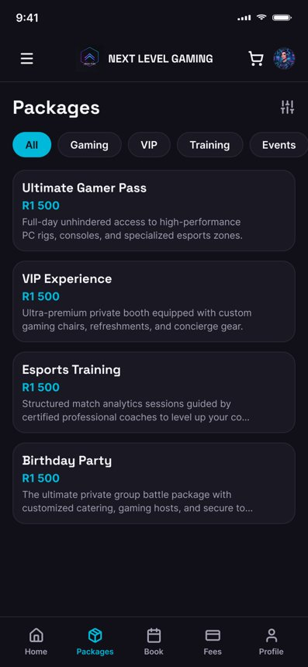
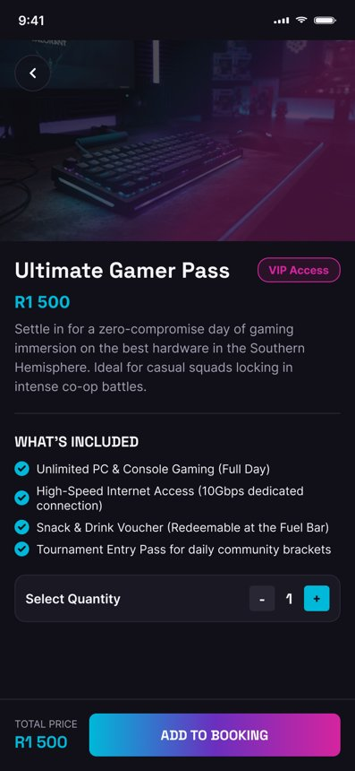
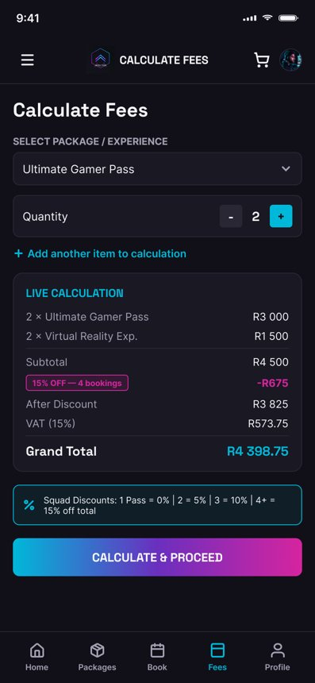
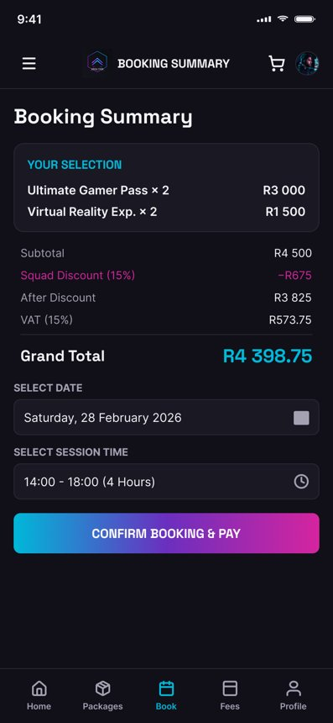
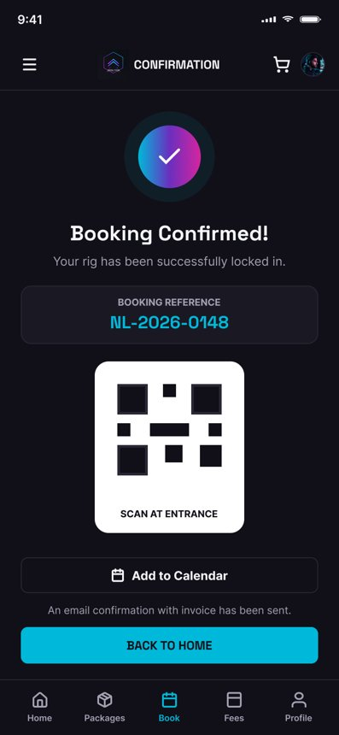
Mobile app design
12 screens: from splash to booking confirmation
Home
Packages
Package detail
Calculate Fees
Booking summary
Confirmation
Bottom navigation (Home, Packages, Book, Fees, Profile) for one-thumb use; live discount and VAT in Calculate Fees; QR confirmation for entry
Presenter: Tshepang Masoka
Notes:
App wireframes: splash, onboarding, login, home, packages, package detail, experiences, calculate fees, booking summary, confirmation, my bookings/profile, contact & about.

Slide 7
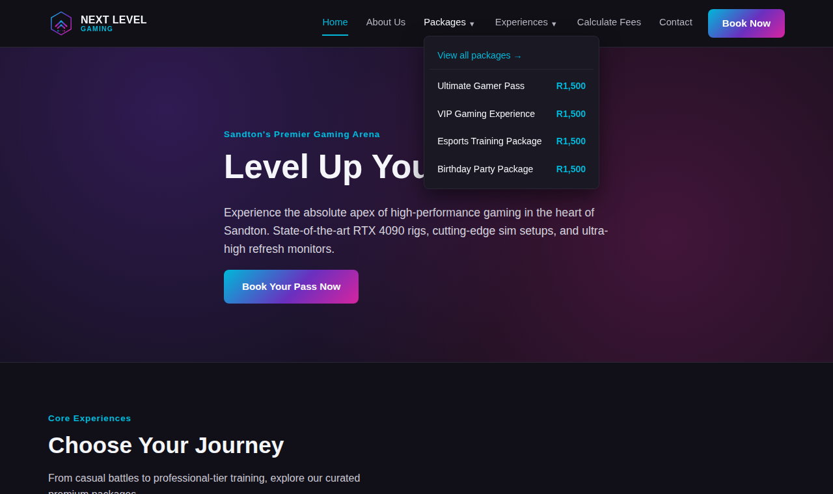
Demo: navigating the website
Drop-down menus reach any package in two clicks
Hover or tap Packages / Experiences to see every item and its price
Works with keyboard and touch; Esc or an outside click closes it
Active page is highlighted automatically
Presenter: Miehleketo Magagula

Slide 8
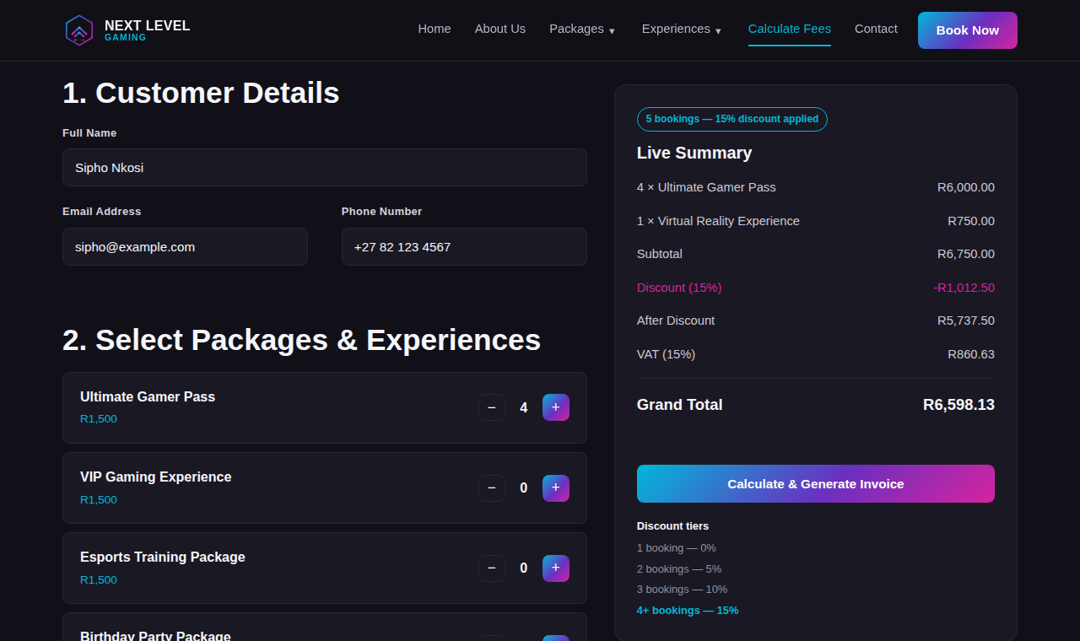
Demo: fee calculator
Live totals, discount tiers, VAT and a printable invoice
Quantity steppers update subtotal, discount (5/10/15%) and 15% VAT instantly
Invoice is a table, with Print Invoice
Continue to Booking Summary, pick a date and slot, then a confirmation page with a reference and calendar file
Validation on every step
Presenter: Karabo Mashishi

Slide 9
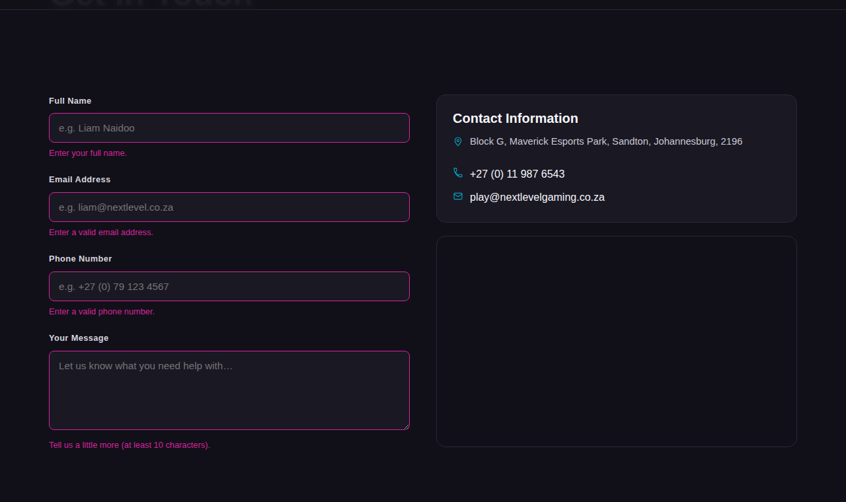
Demo: error handling
Clear feedback instead of silent failure
Contact and fees forms check every field
Invalid fields turn magenta with a message under the field
Nothing is submitted until the form is valid
Presenter: Karabo Mashishi
Notes:
During the demo, submit the empty contact form to show the errors, then fill it in correctly.

Slide 10
Updates & project links
Fee calculator: wireframe's drop-down estimator became live steppers with discount, VAT and an invoice table
Drop-down navigation added for Packages and Experiences
Booking Summary and Confirmation pages built from the wireframes
Package pages and cards now read from one shared data file
WIL Coordinator feedback: [add if received]
Links
GitHub: github.com/htryway/Group-Assignment
Figma: Next Level Gaming - Phase 3 Wireframes
Website: htryway.github.io/Group-Assignment
Website demo: youtube.com/shorts/dXcxQddaGxs
App demo 1: youtube.com/shorts/PaDxjMd6fPI
App demo 2: youtube.com/shorts/YRog0ehnjOk
Presenter: Miehleketo Magagula

Slide 11
Thank you

